Slide 1
How Population Aging Affects the Macroeconomy
Ronald Lee
University of California at Berkeley
Demography and Economics
rlee@demog.berkeley.edu
PANEL ON DEMOGRAPHICS
Jackson Hole, August 22, 2014

Slide 2
NTA
NTA goes beyond national accounts in two important new ways.
  breaks down national accounts by age.
  estimates transfers within families and households, between households, and through the public sector.
Andy Mason and I co-direct NTA
45 countries have NTA teams working on their accounts.
Based on existing surveys and administrative data
Centralized methods, quality control, training, workshops.

Slide 3
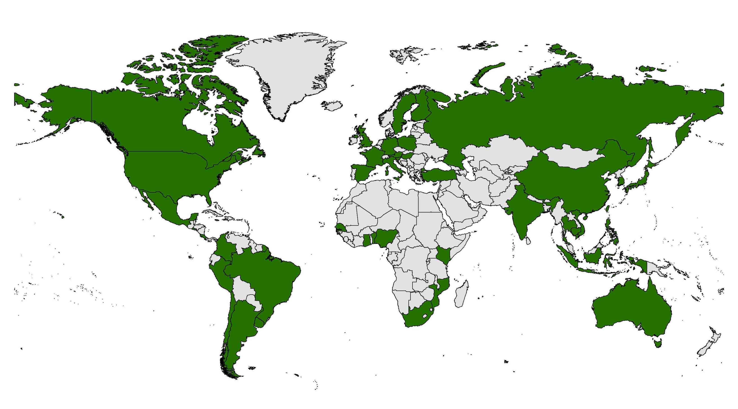
Countries with NTA Teams

Slide 4

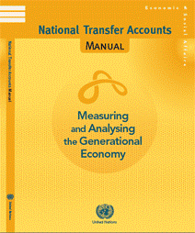
Recent publications, both free downloads (see ntaccounts.org)
Also coming: special NTA issue of Journal of Economics of Aging

Slide 5
The basic budget identity: Inflows = Outflows at each age for individual or for generation
Income inflows =
Expenditure outflows
Asset Inc + Labor Inc + Transfers Rcvd =
Cons + Transfers Given + Saving
OR, rearrange to
Life cycle deficit =
Reallocations
Cons - Labor Inc =
Transfers Rcvd - Transfers Given + Asset Inc - Saving
NTA estimates these flows, and subcomponents, public and private, and by specific type. “Age Profiles”.

Slide 7
Age profiles may change: US cons over past half century: 1960, 1981 and 2007 (Ratio to labor income ages 30-49).
Source: US National Transfer Accounts, Lee, Donehower and Miller, 2011

Slide 8
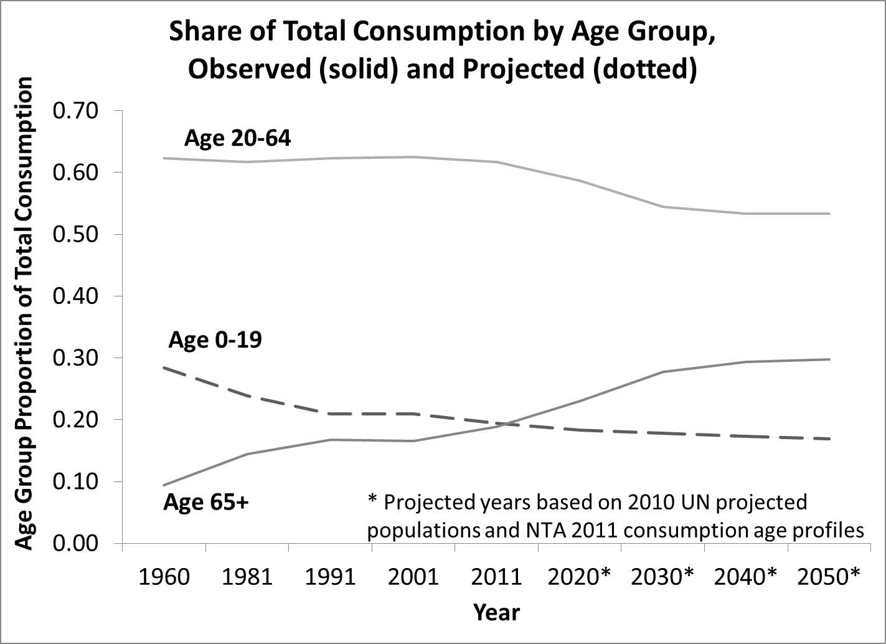

Slide 9
Population age distributions and support ratios
How many working age people are available to support a society’s consumers?
Calculate hypothetical workers and consumers multiplying changing population age distributions times baseline NTA age profiles.
“Support ratio” is:
Resources available per capita are proportional to this support ratio.

Slide 11
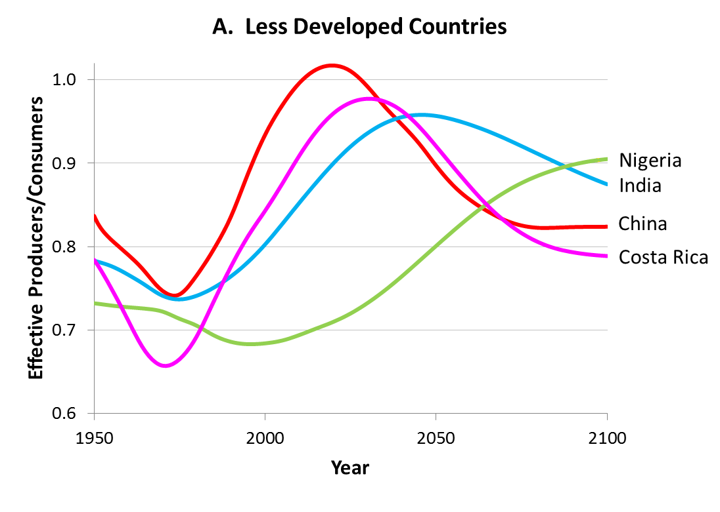
Support ratios based on the average developing country profiles and UN Population Projections
 |  | Rate of change of support ratio
 |  | China | India | Nigeria | Costa Rica
Trough to Peak |  | 0.67 | 0.37 | 0.27 | 0.67
Peak to 2100 |  | -0.26 | -0.17 | na | -0.31

Slide 12
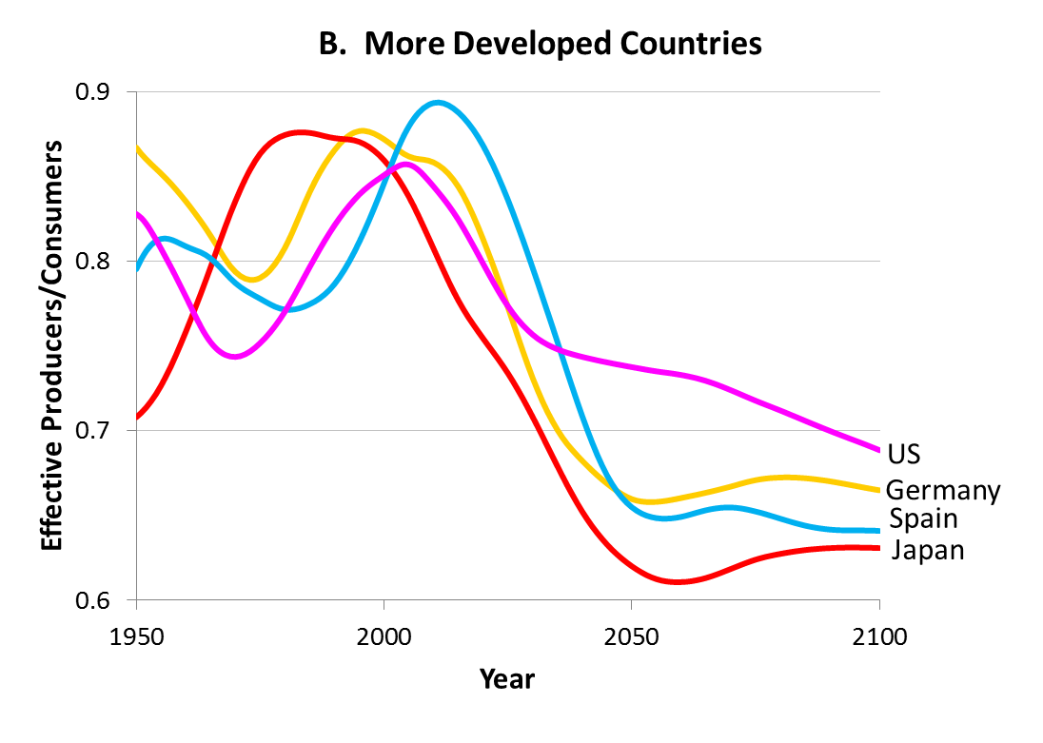
Support ratios based on the average rich country profiles and UN Population Projections
 | Rate of change of support ratio , 2010-2050 (%)
 | Germany | Japan | Spain | US
 | -0.66 | -0.66 | -0.78 | -0.34

Slide 13
How the “life cycle deficit” is financed at each age (US 2003)
Private transfers
Public transfers
Asset income - savings

Slide 14
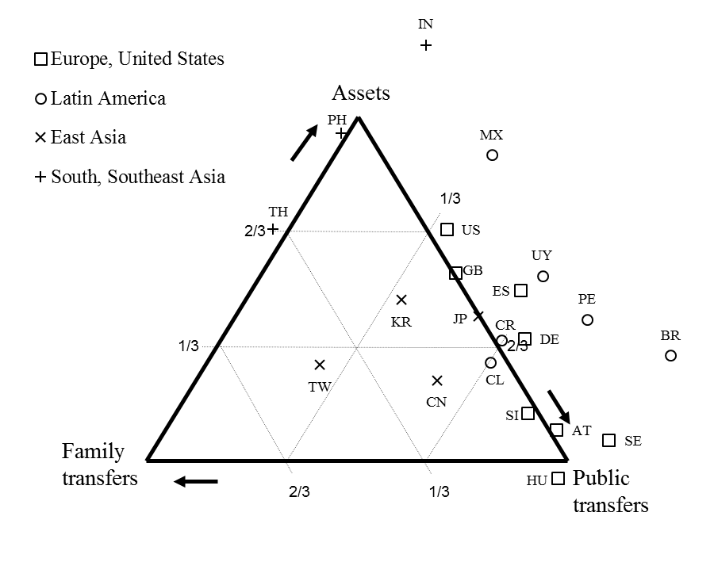
For Elderly (65+): How is consumption net of labor income funded? Shares of Family Transfers, Public Transfers and Asset income not saved sum to 1.0

Slide 15
The “general support ratio” (GSR) reflects both labor income and asset income: how dependent are the elderly?
Do the elderly actually depend on workers to fund their consumption?
Suppose elderly use their own savings for consumption?
GSR reflects use of asset income by elderly to fund own consumption (asset inc – saving).
GSR isolates the impact of population aging on transfers (public and private).
Change in GSR over time shows consequences of pop change if age profiles of consumption, labor income, and asset income remain constant.

Slide 16
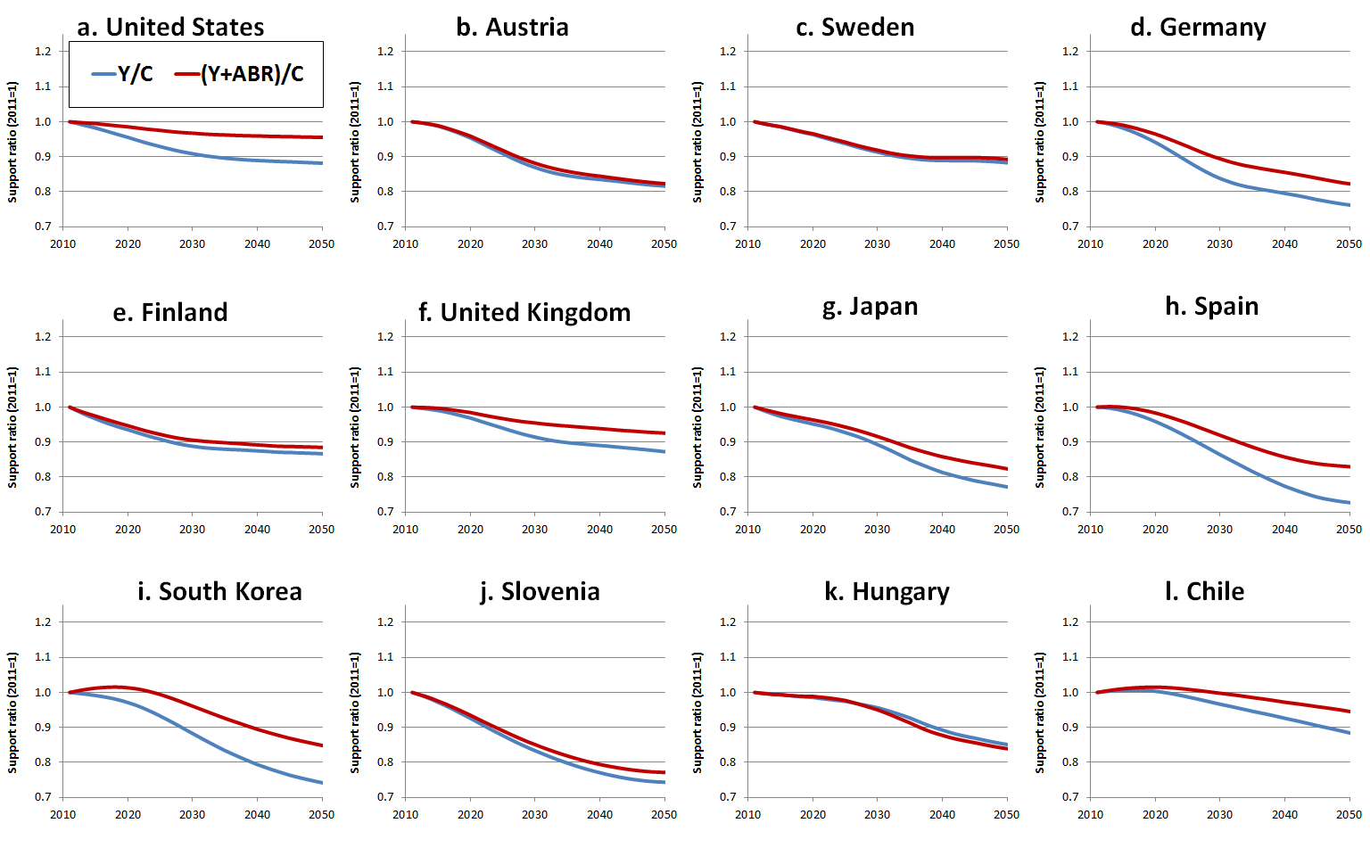
Standard support ratios (blue) and general support ratio (red), scaled to 1.0 in 2010

